Slide 1
Cloud-Based Three-Tier Web Application Deployment for an Online Examination Portal Using AWS Services
Presented By
PUJARI YUVARAJ,258865100045,
PRASAD,258865100039
DarmaTeja,258865100018
ManiKanta,258865100047
Venkata Krishnaarjun,258865100045
UNIVERSITY COLLEGE OF ENGINEERING ,ADHIKAVI NANNAYA UNIVERSITY(AKNU)
RAJAHMUNDRY.

Slide 2
AGENDA
Introduction
Project Overview
Objectives
AWS Architecture
AWS Services Used
Implementation
Advantages
Conclusion

Slide 3
Introduction
The Online Examination Portal is a web-based application that enables students to attend examinations online while allowing administrators to manage exams efficiently. Traditional web hosting suffers from scalability and availability limitations. To overcome these issues, the application is deployed on Amazon Web Services (AWS) using a Three-Tier Architecture with Load Balancing and Auto Scaling.

Slide 4
Project Overview
Online Examination Portal developed using Flask Hosted on Amazon Web Services (AWS) Uses Three-Tier Architecture Secure HTTPS communication High Availability using Load Balancer Automatic Scaling using Auto Scaling Group

Slide 5
Objectives
Develop an online examination portal
Deploy on AWS Cloud
Secure communication using HTTPS
Store data in PostgreSQL
Load balancing
High availability
Better performance

Slide 6
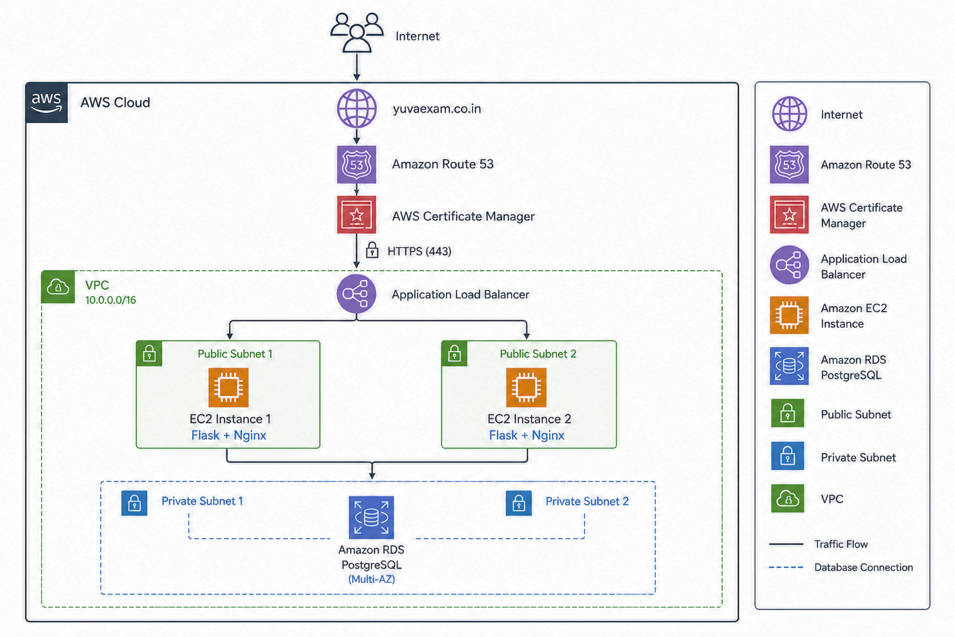
AWS Architecture

Slide 7
AWS Services Used
Service | Purpose
EC2 | Host Application
VPC | Network
RDS | Database
ALB | Load Balancer
ASG | Scaling
Route53 | DNS
ACM | SSL
Security Groups | Firewall

Slide 8
Implementation
Create VPC
Create RDS
Launch EC2
Deploy Flask app
Gunicorn
Auto Scaling
Load Balancer
Route53
SSL
Nginx

Slide 9
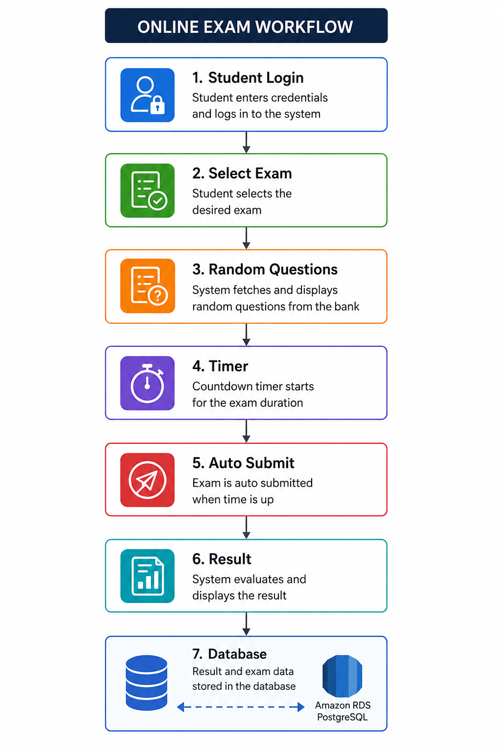
Project Workflow
Student Login
↓
Select Exam
↓
Random Questions
↓
Timer
↓
Auto Submit
↓
Result
↓
Database

Slide 10
Advantages
High Availability
Scalability
Secure HTTPS
Load Balancing
Automatic Scaling
Managed Database
Easy Deployment

Slide 11
Conclusion
Successfully developed a cloud-based online examination portal.
Deployed using AWS services.
Secure, scalable, and highly available.
Supports multiple users efficiently.
Live Website
https://yuvaexam.co.in

Slide 12
THANK YOU

